Slide 1
Artificial Neural Network (ANN)
Artificial neural network" refers to a biologically inspired sub-field of artificial intelligence modeled after the brain.
An Artificial neural network is usually a computational network based on biological neural networks that construct the structure of the human brain.

Slide 2
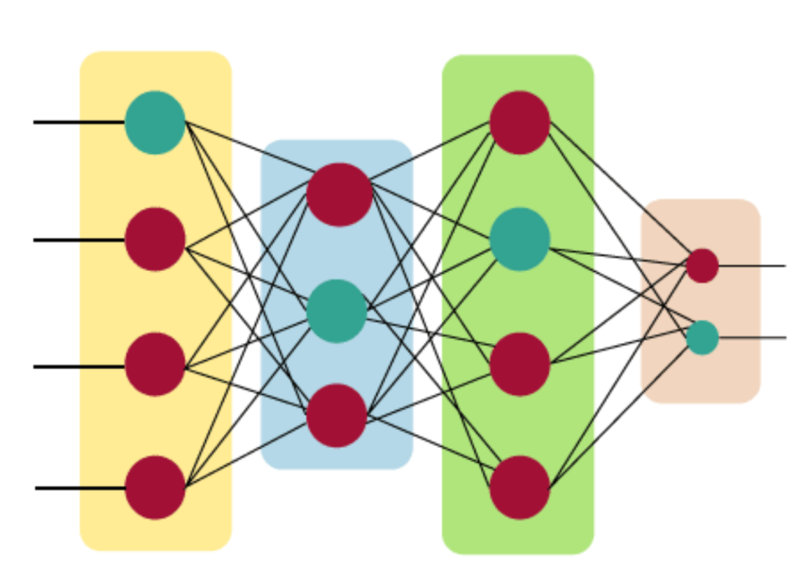
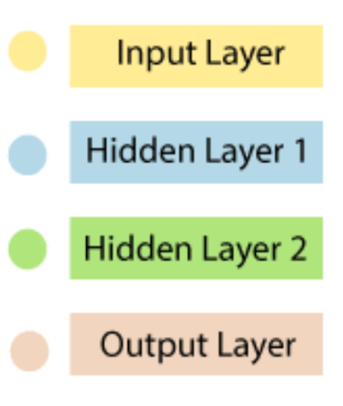
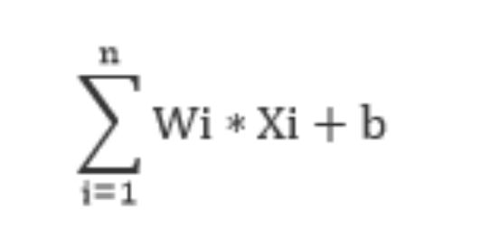
The Architecture of an Artificial Neural Network
Artificial Neural Network primarily consists of three layers:
The artificial neural network takes input and computes the weighted sum of the inputs and includes a bias. This computation is represented in the form of a transfer function.

Slide 3
The Architecture of an Artificial Neural Network Cont’d
Input Layer:
As the name suggests, it accepts inputs in several different formats provided by the programmer.
Hidden Layer:
The hidden layer presents in-between input and output layers. It performs all the calculations to find hidden features and patterns.
Output Layer:
The input goes through a series of transformations using the hidden layer, which finally results in output that is conveyed using this layer.

Slide 4
Terminologies in Artificial Neural Network
Parameters:
weights
Bias
Hyper-parameters: The control the parameters
Learning rate
Optimizer
Number of layers
Activation function
Loss function
Number of neurons

Slide 5
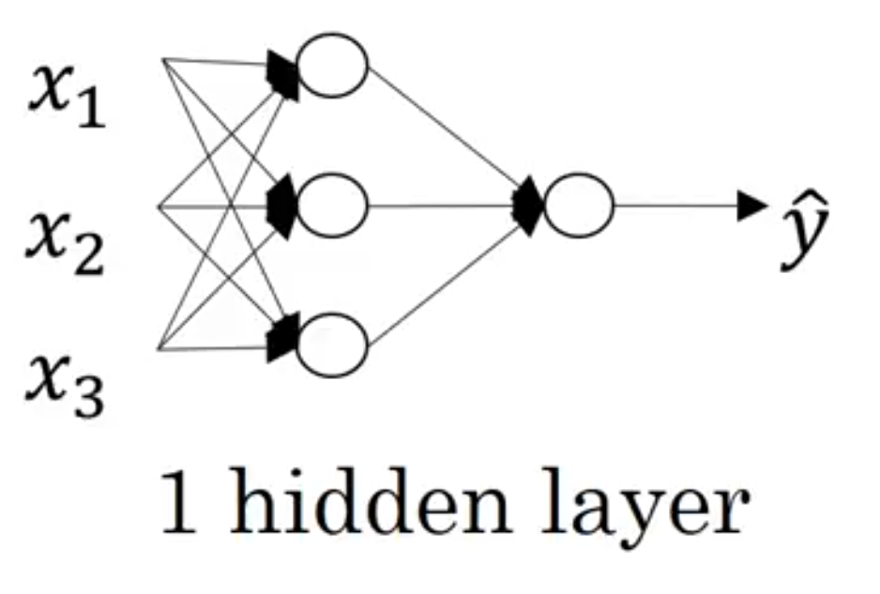
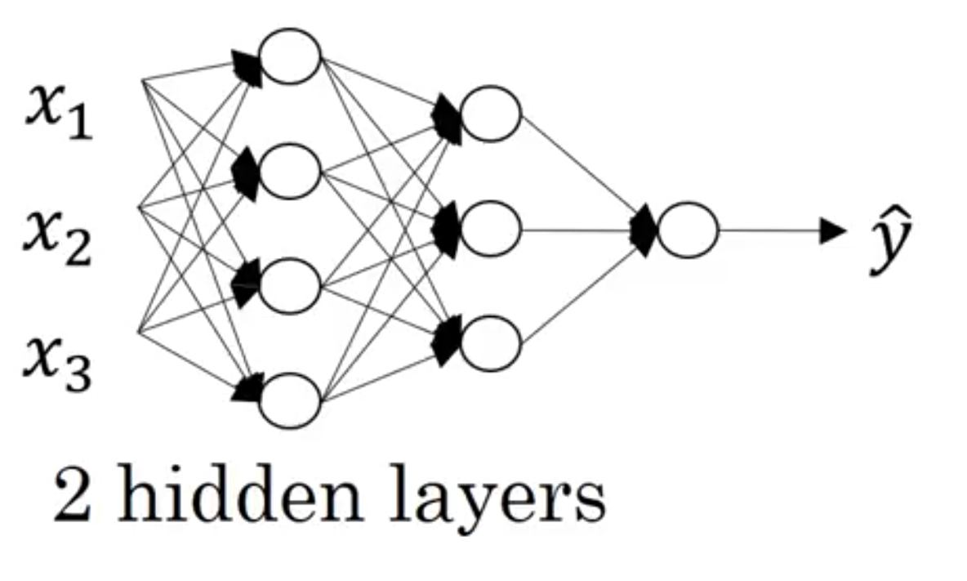
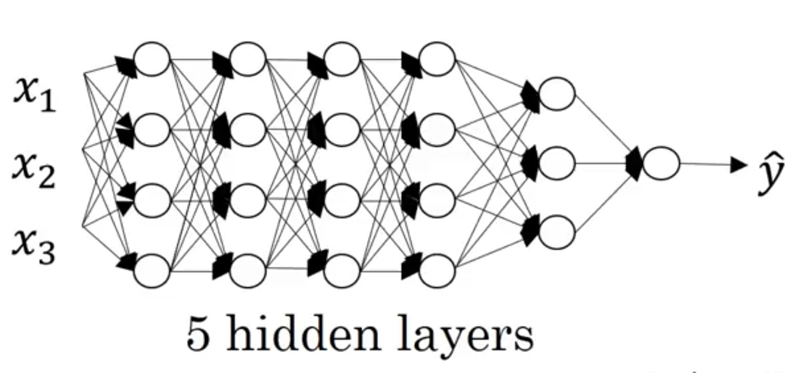
Implementation of Artificial Neural Network

